Slide 1
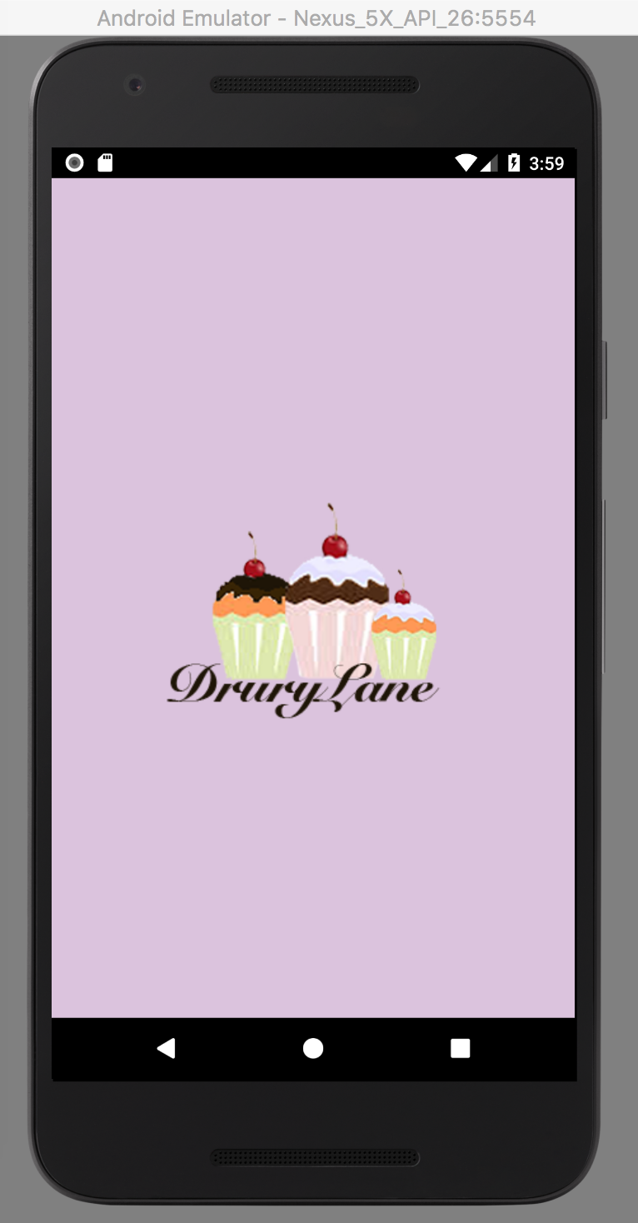
Drury Lane App
Android Mobile Application Project
Team: Adam Bazzi, Tyler Mackenzie, Machael Ellakkis

Slide 2



The Brains Behind it
Team Members
Adam Bazzi (Team Leader)
Tyler Mack
Machael Ellakkis
Mentor
Cai Filiault

Slide 3
Content
Project Objective
Time & Research
Members Contributions
Issues Encountered
Software Requirements
Context Diagram
Final Product
Future Enhancements
What We Learn?
References

Slide 4
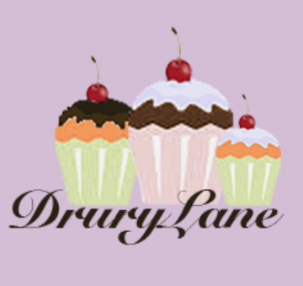
Project Objective
To develop an Android Application which will provide a digital interface of our cup cake business Drury Lane to customers where they can order products, contact us and learn more about our business

Slide 5
Time, Research & Members Contributions
Bazzi
Tyler
Ellakkis
Premade dessert
Styling the App
Picking The color scheme
Designing the layouts
Creating a Social Media Buttons
Credits
About Us
Web intent
Call intent
Google MapsAPI
Animations for Fragments
Custom order cup cakes
Email intent
Splash screen
Logo
Cup cakes images
Icon launcher images
3 weeks of work
Researched Fade animation

Slide 6
Issues Encountered
Item alignments
Implementing the Google Maps API & deciding between a MapsFragment and MapsActivity
Finding a way to reuse fragments in the application
Intent Bugs

Slide 7
Software Requirements
Android Library
Android Studio Software
Photoshop
Git + Github

Slide 8
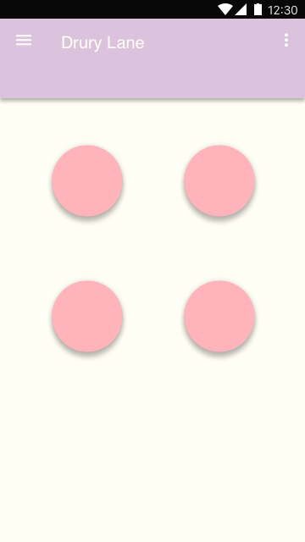
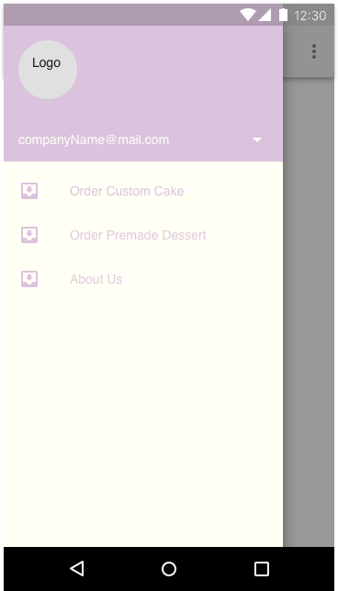
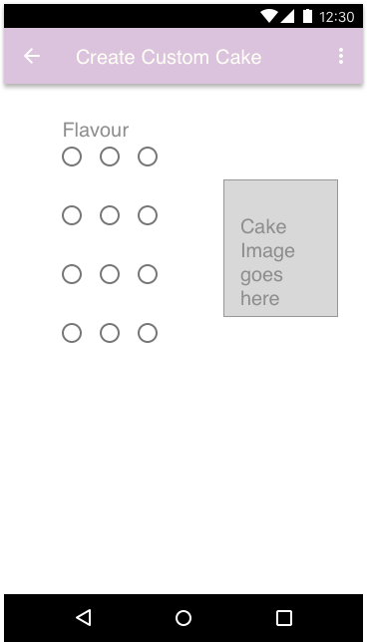
Context Diagram

Slide 9
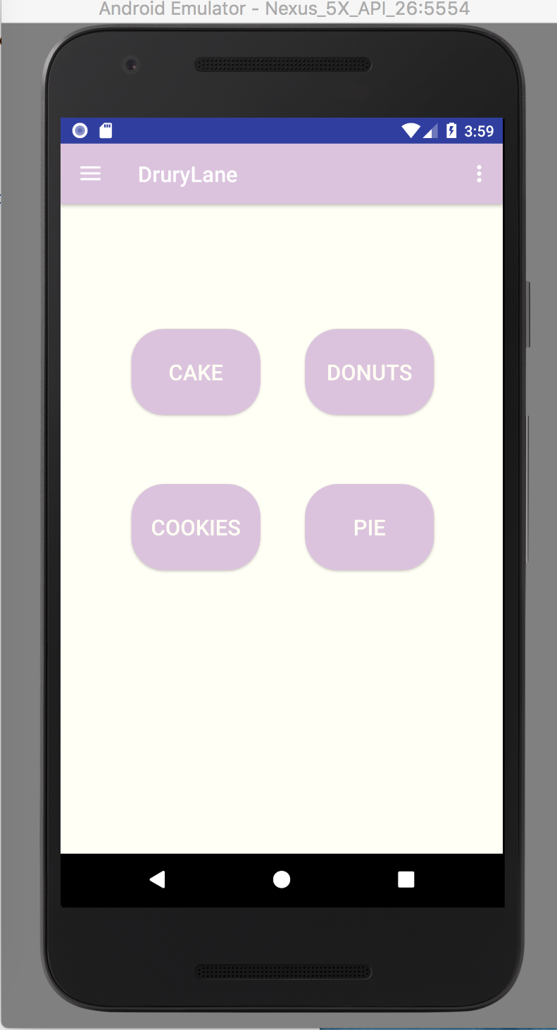
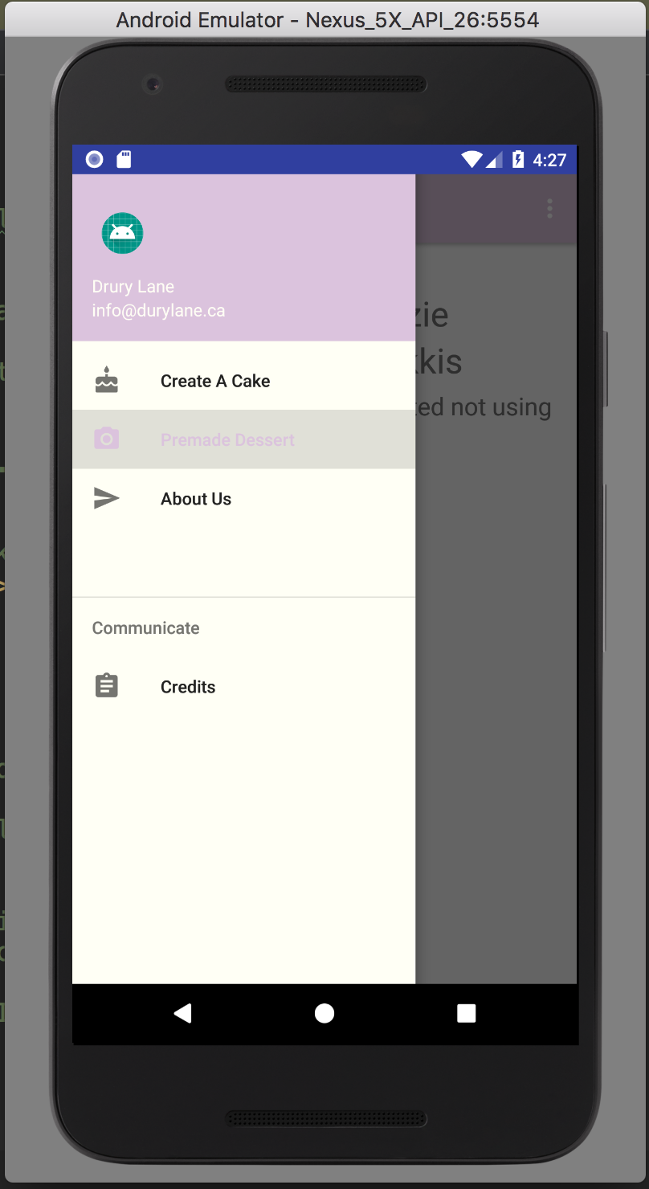
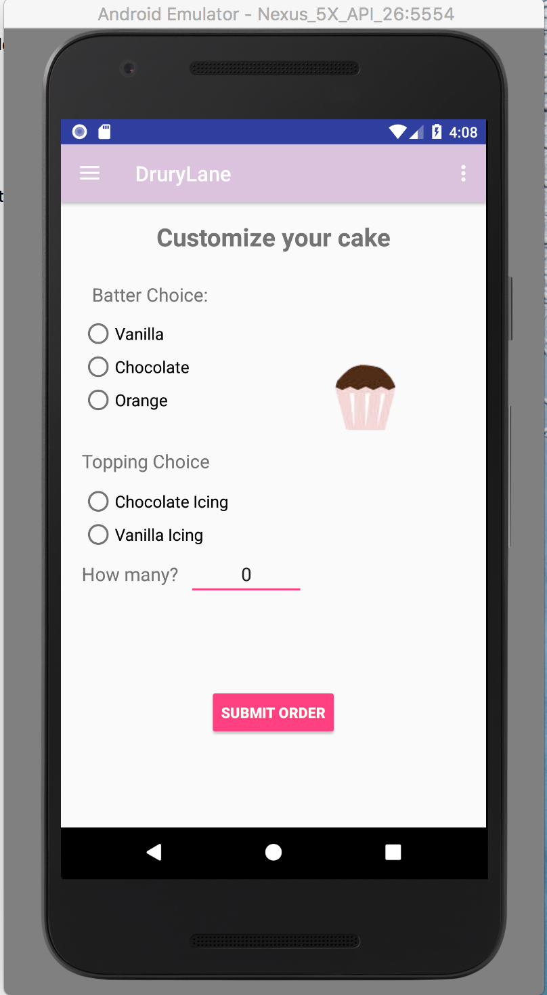
Final Product

Slide 10
Future Enhancements
Implement Shopping cart to get multiple orders in it first and then submit to email
Change the Premade Deserts Look and Feel to include images instead of buttons

Slide 11
What We Learn?
More on Android Programming
Fragmentation
Android Web Viewer
Navigation Drawer
ViewPager with Views
Android APIs
Maps
Call
web
Email

Slide 12
References
https://console.developers.google.com/apis/credentials/key/212?project=androidproject-189504

Slide 13
External Sources
Font awesome was used for the social meida buttons

